Slide 1
Design and Implementation of a Database Management System for
E-Commerce Order, Return and Refund Management System
📸 SCREENSHOTS WALKTHROUGH • OCT 2026

Slide 2
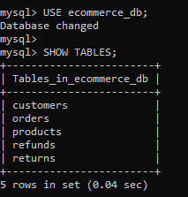
Entities • Screenshot 01

Slide 3
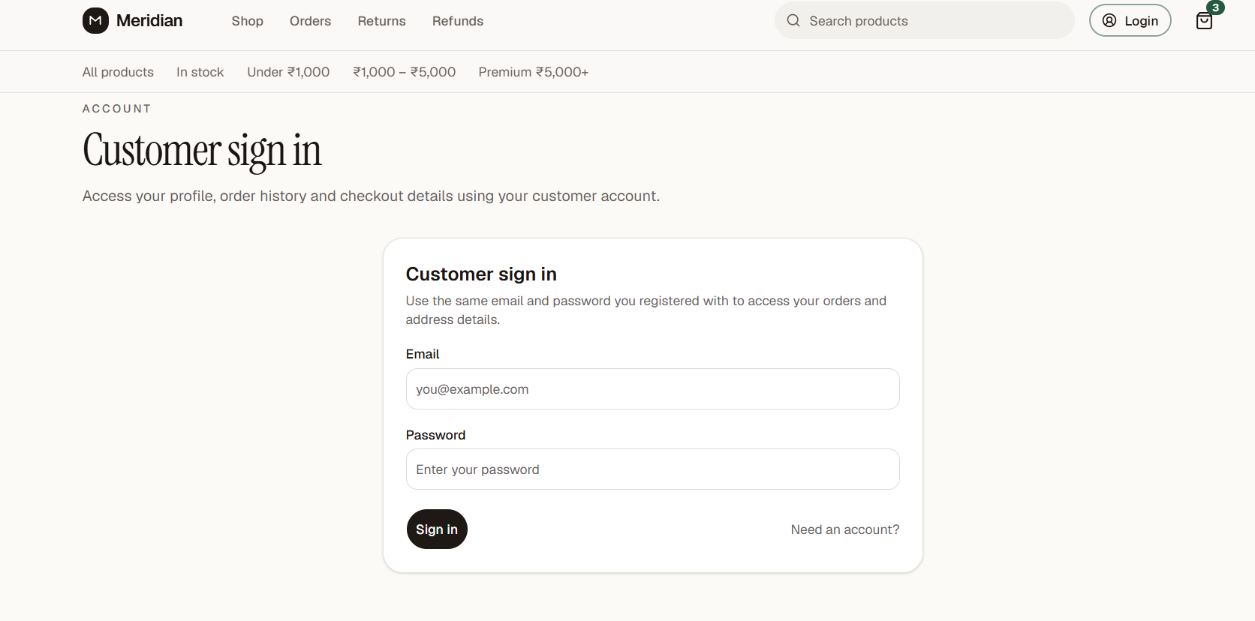
Login Page • Screenshot 02
Database for Customer Details

Slide 4
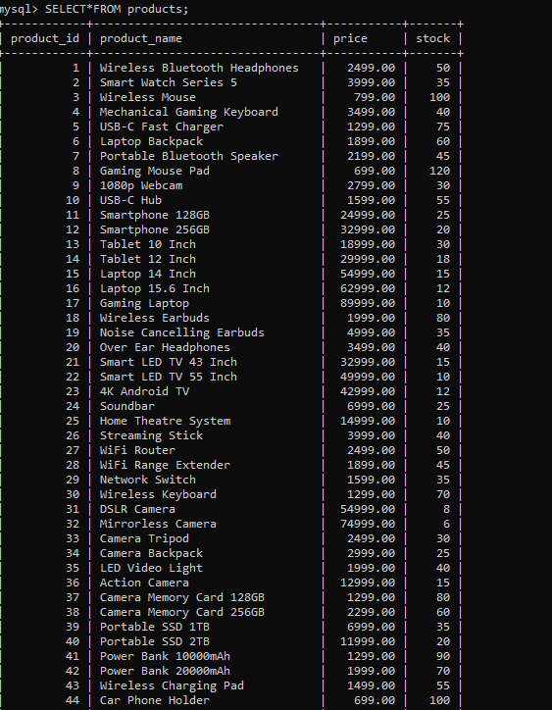
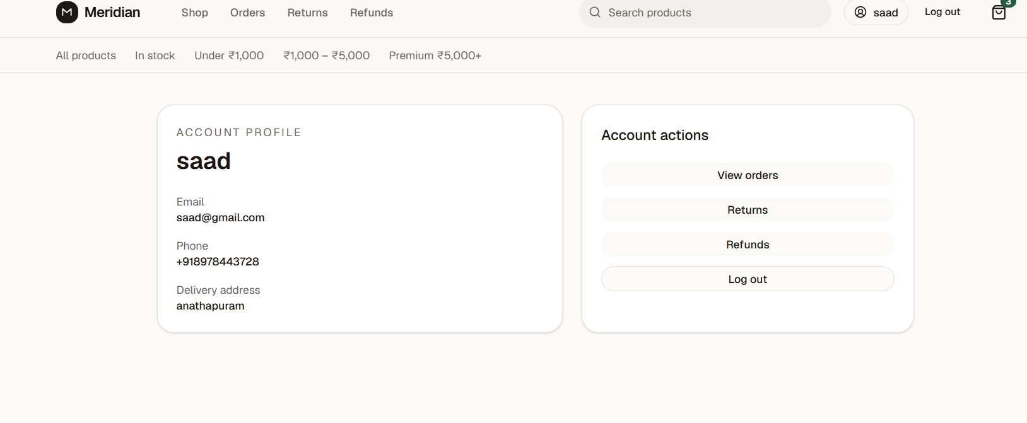
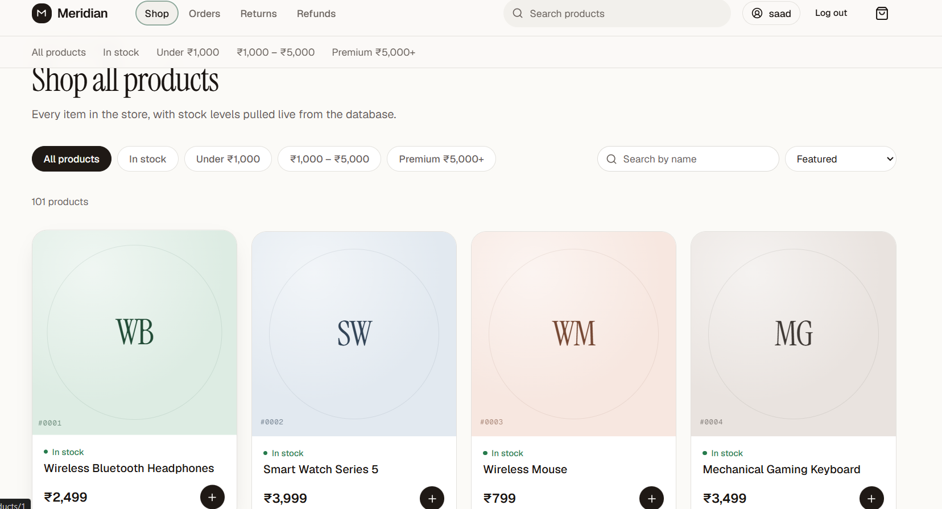
Products Database
My Profile • Screenshot 03
Products List to Place an Order • Screenshot 04

Slide 5
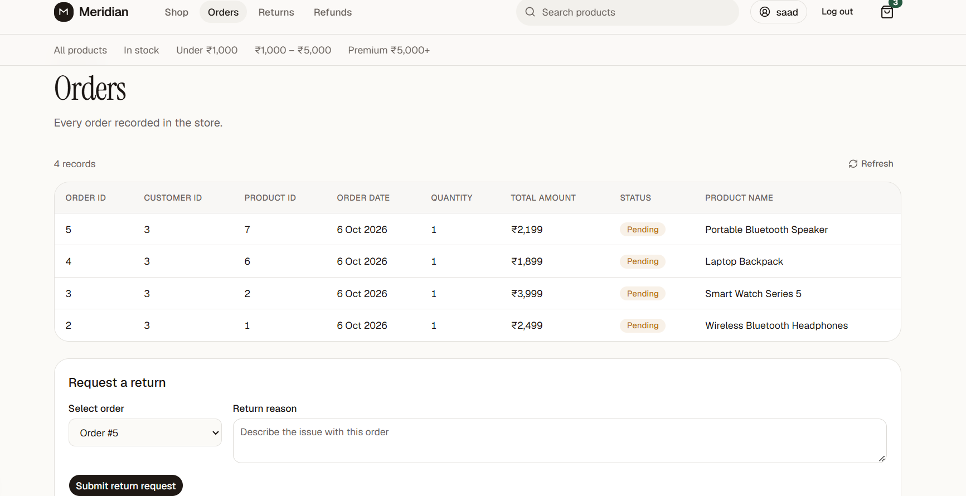
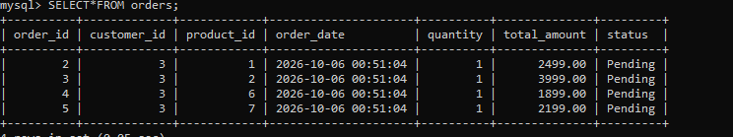
Orders Placed by Customer • Screenshot 05
Orders Database

Slide 6
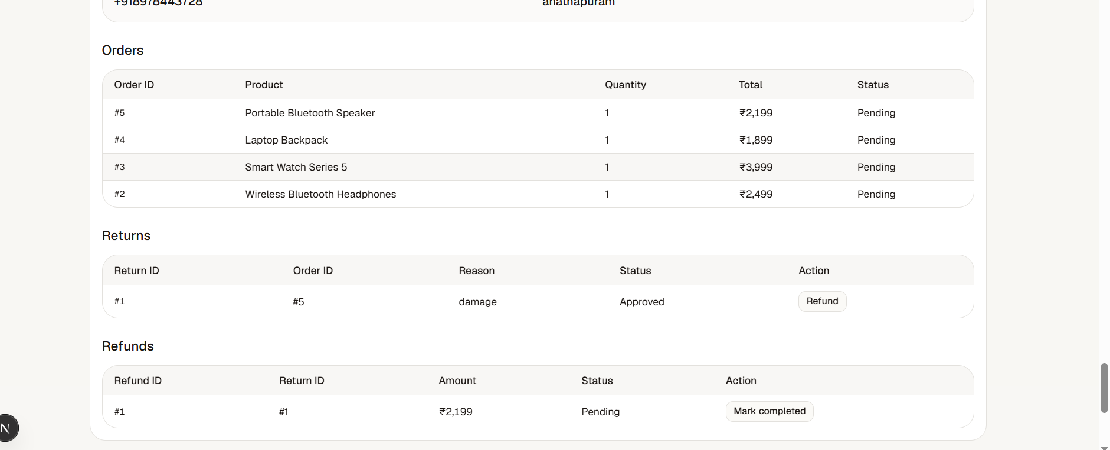
Order Return and Refund • Screenshot 06

Slide 7
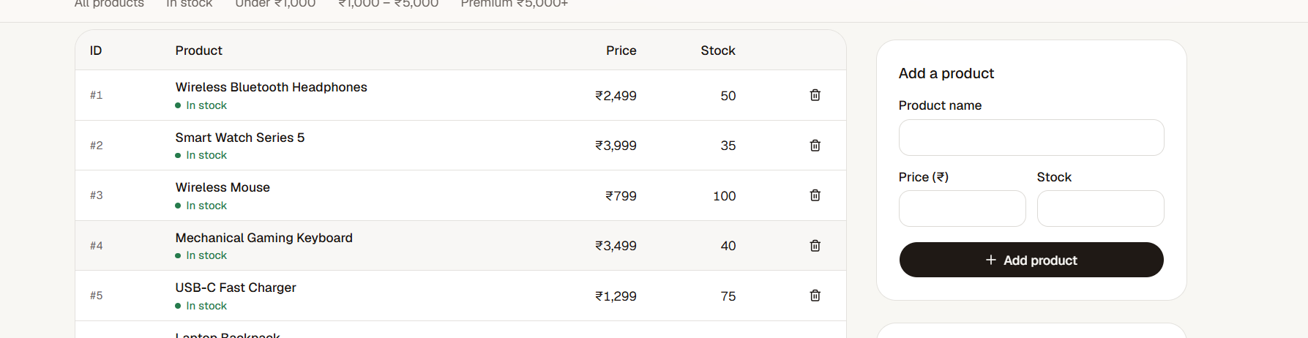
Products for Admin — Insertion & Deletion • Screenshot 07

Slide 8
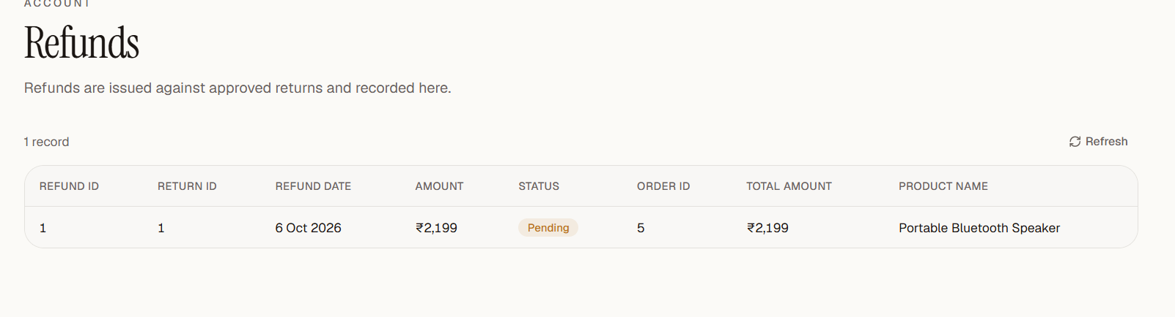
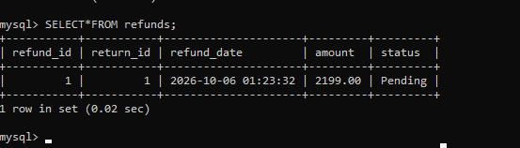
Refunds • Screenshot 08
Refunds Database

